Slide 1
Introducing the PowerShell GitHub Repository
Adam Driscoll

Slide 2



Adam Driscoll
Senior Software Developer @ STEALTHbits
Cloud and Datacenter MVP
Developer of PowerShell Tools for Visual Studio
Globetrotter
Endurance Athlete

Slide 3
Goals
Contribute to Open Source PowerShell
Build and modify PowerShell source code

Slide 4
Agenda
Hour 1
Configure our environments
Learn about open source PowerShell and the GitHub repository
File an issue
Hour 2
Clone the source code and build and run
Extend a cmdlet
Write a test for cmdlet
Create a pull request
Hour 3
Examine the runtime and language components
Modify the PowerShell console progress behavior

Slide 5
Environment configuration
Required Software
Git
Visual Studio
.NET CLI (dotnet)
Windows 10 SDK
Optional Software
Visual Studio Code
Notes:
choco install git.install
https://www.visualstudio.com/vs/community/
Start-PSBootstrap

Slide 6
Open Source PowerShell What’s it mean?
PowerShell developed in the open, taking contributions from the community
PowerShell for every system!
PowerShell no longer linked to Windows

Slide 7
Open Source PowerShell Repositories
PowerShell Engine and PowerShell.exe
PowerShellGet
PowerShell-Docs
PowerShell-RFC
Win32-OpenSSH
PowerShellEditorServices
PSReadLine

Slide 8
Getting around GitHub
Introduction to GitHub
Contributing
Issues
Pull Requests
Continuous Integration

Slide 9
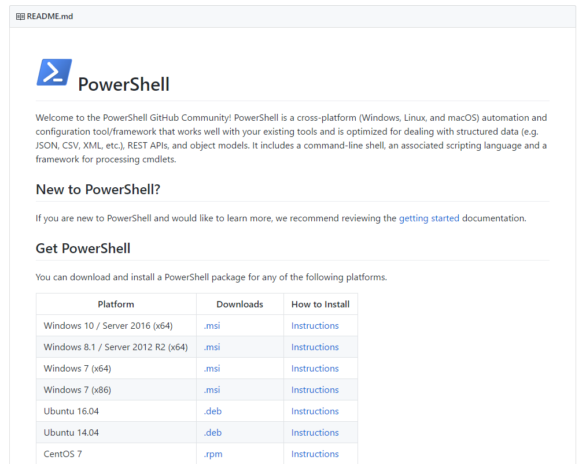
Getting around GitHub Introduction to GitHub

Slide 10
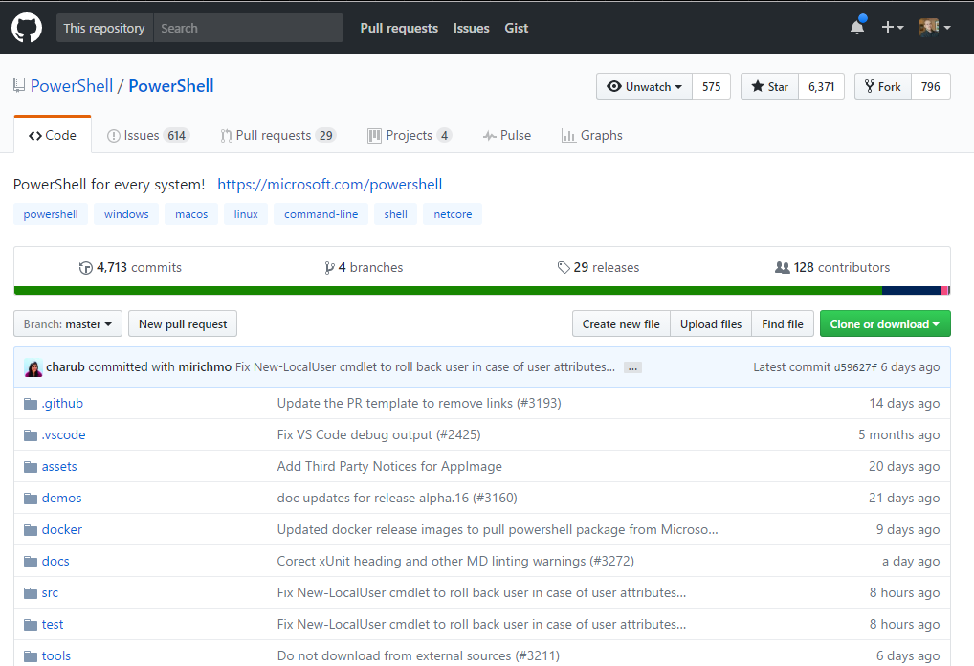
Getting around GitHub Introduction to GitHub

Slide 11
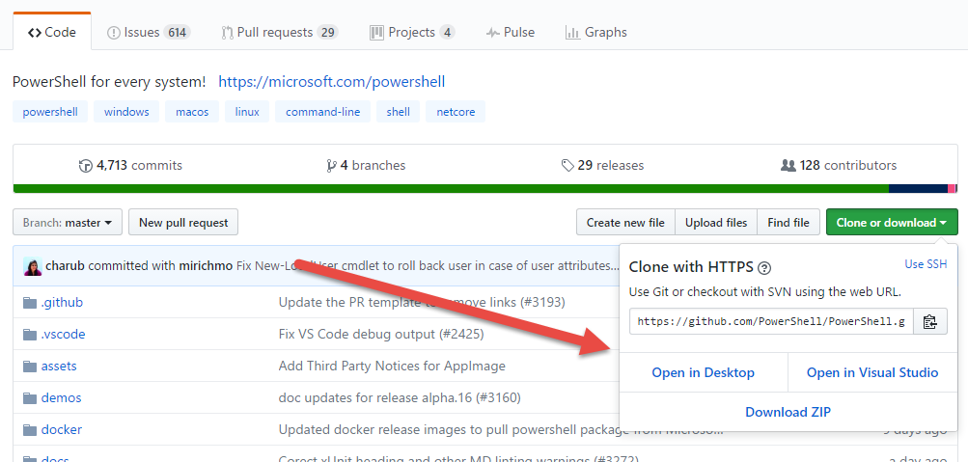
Getting around GitHub Introduction to GitHub

Slide 12
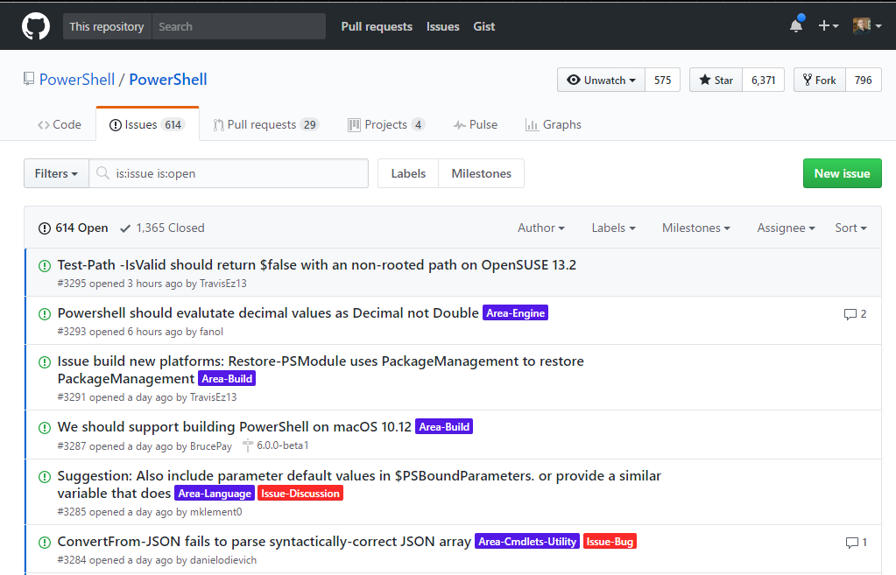
Getting around GitHub Introduction to GitHub

Slide 13
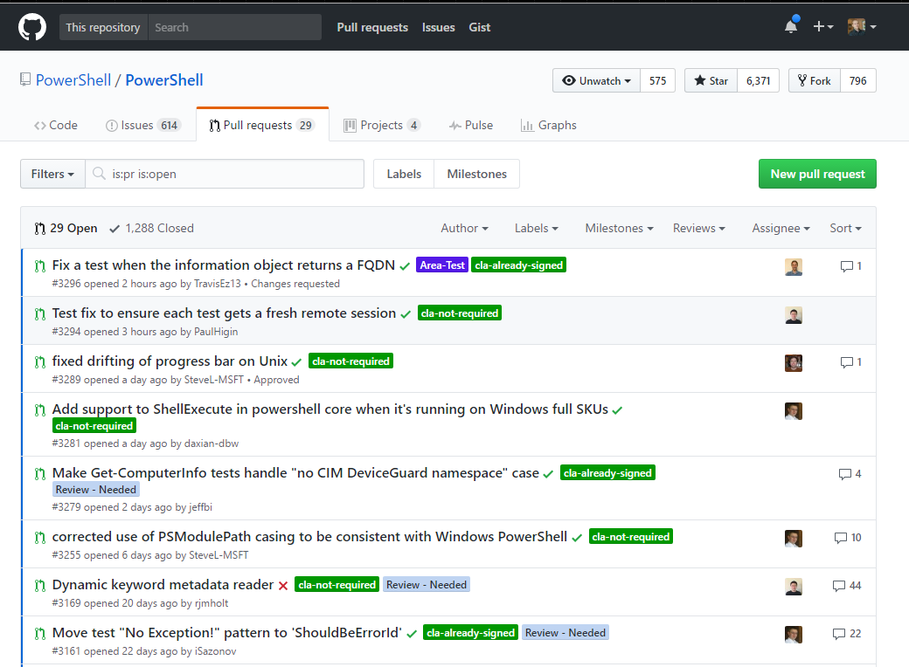
Getting around GitHub Introduction to GitHub

Slide 14
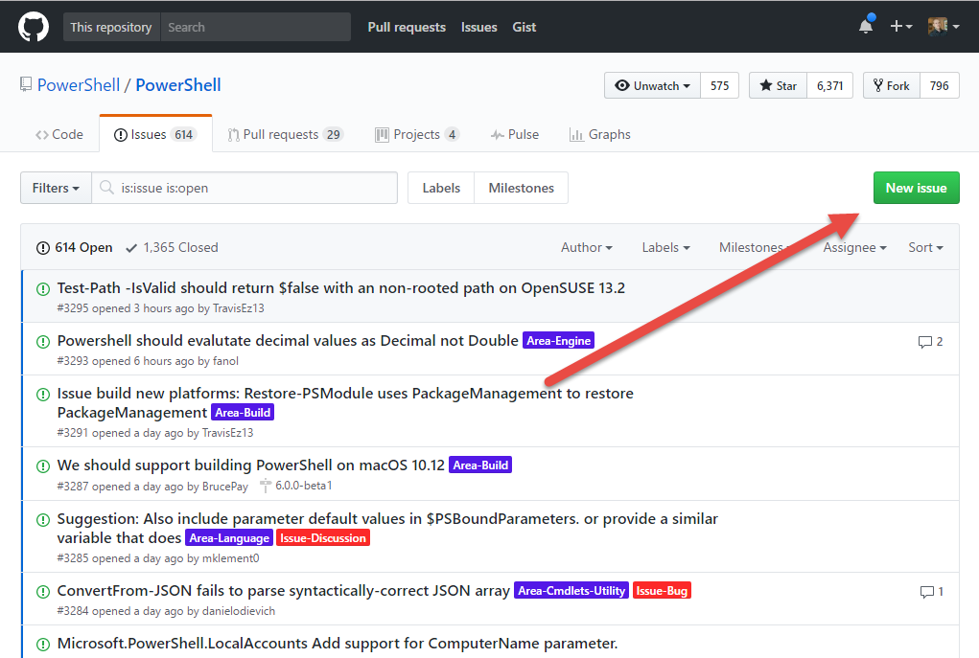
Getting around GitHub Contributing: Issues

Slide 15
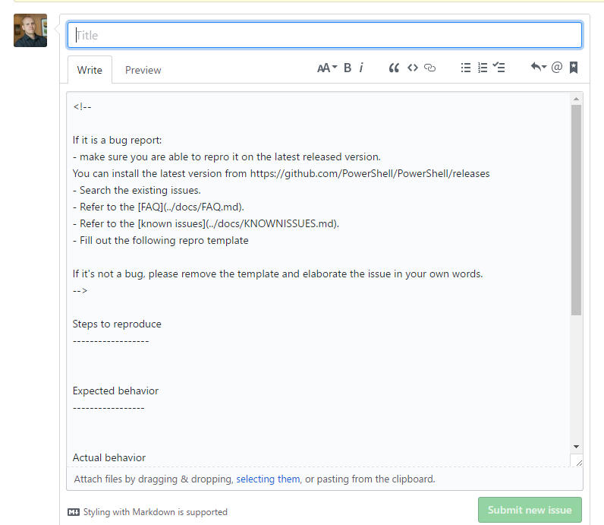
Getting around GitHub Contributing: Issues

Slide 16
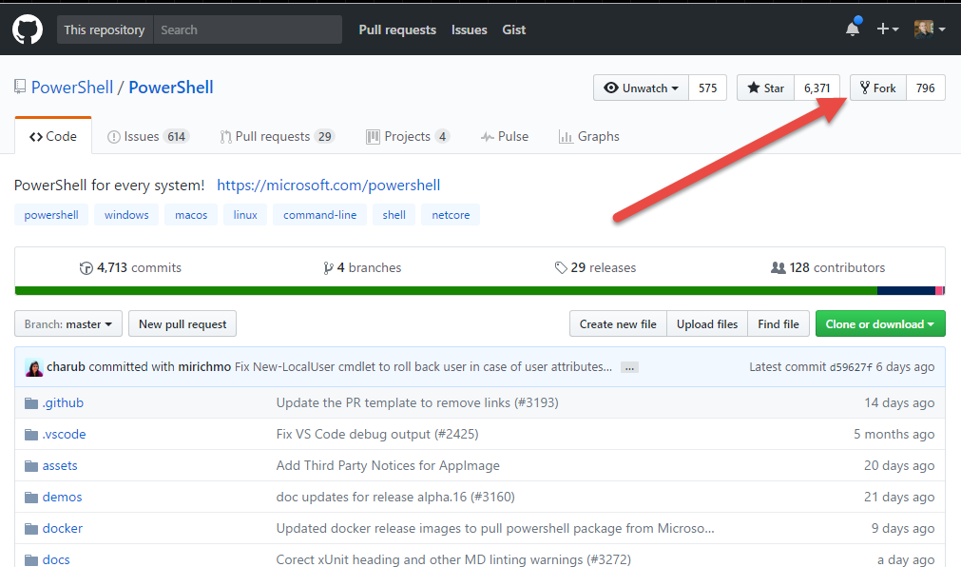
Getting around GitHub Contributing: Pull Requests

Slide 17
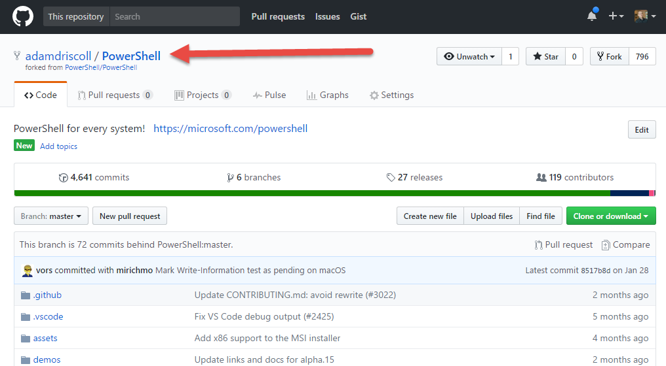
Getting around GitHub Contributing: Pull Requests

Slide 18
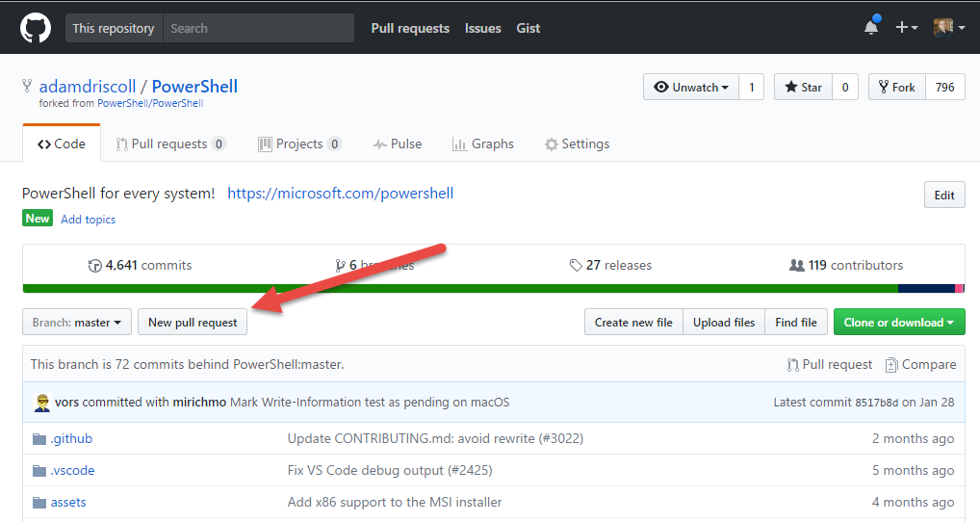
Getting around GitHub Contributing: Pull Requests

Slide 19
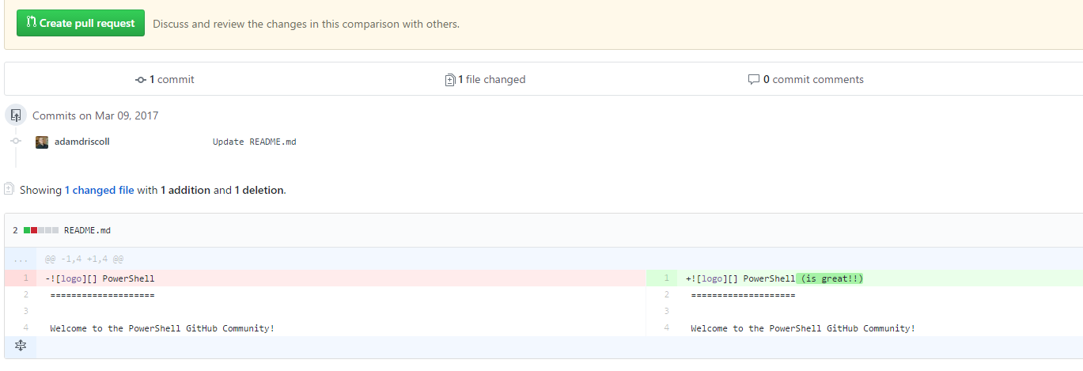
Getting around GitHub Contributing: Pull Requests

Slide 20
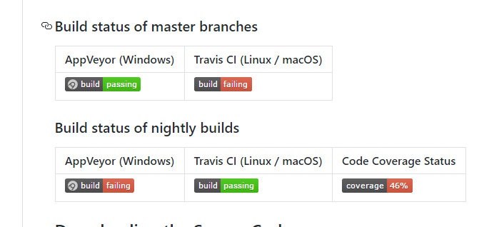
Getting around GitHub Continuous Integration

Slide 21
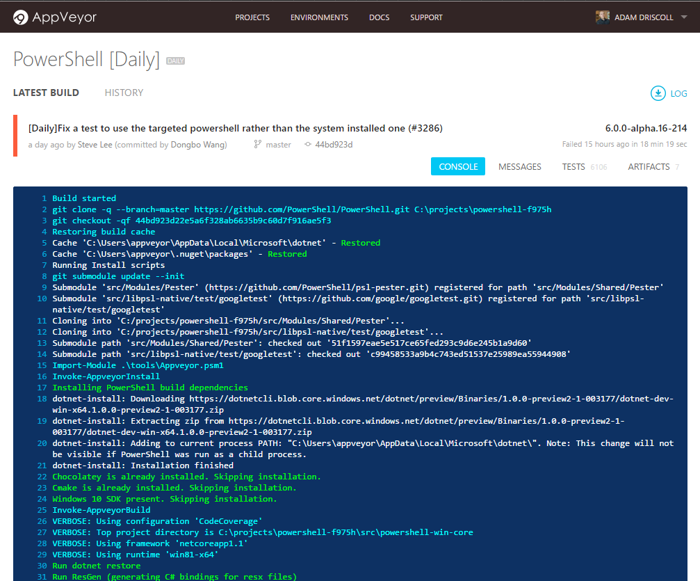
Getting around GitHub Continuous Integration

Slide 22
Building PowerShell
Start-PSBuild
Building with Visual Studio Code

Slide 23
Lab 1 – Your first contributions
Add a new issue to the PowerShell repo
Update some documentation and create a pull request
Join in on the RFC discussions

Slide 24
Lab 2 – Getting the source and building it
Download Git, Visual Studio, Visual Studio Code and dotnet core
Fork the PowerShell repository
Clone source locally
Build using Start-PSBuild or Visual Studio Code
Run your own version of PowerShell!
Notes:
Maybe how USB keys with all this stuff on them.
https://github.com/PowerShell/PowerShell/issues/3383

Slide 25
Source Layout
System.Management.Automation – Main PowerShell assembly
Language
Compiler
Parser
Engine
Debugger
PowerShell – PowerShell.exe
Microsoft.PowerShell.Commands.* - Built-in modules
Tests – 3000+ Pester tests. PowerShell testing PowerShell

Slide 26
Tips for finding source code
VS Code or GitHub Search
Classes are usually similar to cmdlet names (Format-Hex -> FormatHex.cs)
Get-Module and manifests
Module names point to assemblies
Module manifests point to additional assemblies
Ask a friend
Gitter
Issues
Twitter

Slide 27
Lab 3 – Updating a cmdlet
Extend Format-Hex to accept a count and offset to output only a section of a file
Write a pester test for Format-Hex

Slide 28
Lab 4 – Update the console
Add a new progress function to customize the console

Slide 29
Find me!
Twitter: @adamdriscoll
GitHub: https://github.com/adamdriscoll
Blog: https://wandering.life

